Slide 1

Skill Matrix Filler App Overview
Streamlining resume and skill data management
Notes:
AI-generated content may be incorrect. --- In this presentation, we will explore the Skill Matrix Filler App, designed to streamline the management of resumes and skill data. We will cover the challenges faced in manual processes, outline our innovative solution, and discuss the core functionalities and key technologies that ensure efficiency and reliability.

Slide 2

Meeting Program
Introduction to Skill Matrix Filler App
Challenges in Manual Resume and Skill Data Management
Skill Matrix Filler App Solution
Core Functionality: Intelligent Resume Parsing
Core Functionality: Intelligent Question Answering
Core Functionality: Dynamic Template Filling
Key Technologies
Ensuring Accuracy and Reliability
Notes:
This presentation is structured into several key sections. We will start with an introduction to the Skill Matrix Filler App, followed by the challenges associated with manual resume management. We will then present our solution and delve into the core functionalities, before discussing the key technologies that drive the app. Finally, we will address accuracy and reliability concerns.

Slide 3

Title Slide
Skill Matrix Filler App
The Skill Matrix Filler App is designed to enhance HR automation, focusing on efficient resume processing.
Intelligent Automation
Utilizing intelligent automation to streamline HR processes saves time and enhances accuracy in skill management.
Efficient Skill Management
The app facilitates effective skill management, allowing organizations to easily track and manage employee competencies.
Notes:
--- This slide references information from the following file: https://watiusa-my.sharepoint.com/personal/rajesh_j_wati_com/_layouts/15/Doc.aspx?sourcedoc=%7B325946ED-BE65-4FCA-B439-612EC71673B7%7D&file=Skill%20Matrix%20Filler%20App_ppt_document%20(1).docx&action=default&mobileredirect=true Skill Matrix Filler App Slide 1: Title Slide Title: Skill Matrix Filler App: Intelligent Automation for HR Subtitle: Streamlining Resume Processing and Skill Management Your Name/Department

Slide 4
Challenges in Manual Resume and Skill Data Management
Notes:
--- This slide references information from the following file: https://watiusa-my.sharepoint.com/personal/rajesh_j_wati_com/_layouts/15/Doc.aspx?sourcedoc=%7B325946ED-BE65-4FCA-B439-612EC71673B7%7D&file=Skill%20Matrix%20Filler%20App_ppt_document%20(1).docx&action=default&mobileredirect=true The Challenge, Need for Faster Talent Identification

Slide 5

The Challenge
Time-Consuming Processes
Extracting data manually from numerous resumes takes significant time and resources, hindering efficiency.
Human Error Risks
Manual data entry introduces the potential for human error, leading to inconsistencies and inaccuracies in data.
Notes:
--- This slide references information from the following file: https://watiusa-my.sharepoint.com/personal/rajesh_j_wati_com/_layouts/15/Doc.aspx?sourcedoc=%7B325946ED-BE65-4FCA-B439-612EC71673B7%7D&file=Skill%20Matrix%20Filler%20App_ppt_document%20(1).docx&action=default&mobileredirect=true Slide 2: Introduction - The Challenge Title: The Challenge of Manual Resume and Skill Data Management Bullet Points: Time-consuming manual data extraction from numerous resumes. Potential for human error and inconsistencies in data entry.

Slide 6

Need for Faster Talent Identification
Candidate Skill Identification
There is a significant difficulty in quickly identifying candidates with specific skills necessary for roles.
Tedious Reporting Process
The current process involves tedious tasks such as filling out skill matrices and generating lengthy reports.
Need for Speed and Accuracy
There is an urgent need for faster and more accurate methods of talent identification in recruitment.
Notes:
--- This slide references information from the following file: https://watiusa-my.sharepoint.com/personal/rajesh_j_wati_com/_layouts/15/Doc.aspx?sourcedoc=%7B325946ED-BE65-4FCA-B439-612EC71673B7%7D&file=Skill%20Matrix%20Filler%20App_ppt_document%20(1).docx&action=default&mobileredirect=true Difficulty in quickly identifying candidates with specific skills. Tedious process of filling out skill matrices and generating reports. Need for faster and more accurate talent identification. Image Suggestion: A split image: on one side, a person looking overwhelmed by a stack of paper resumes; on the other side, a clock indicating wasted time.

Slide 7
Skill Matrix Filler App Solution
Notes:
--- This slide references information from the following file: https://watiusa-my.sharepoint.com/personal/rajesh_j_wati_com/_layouts/15/Doc.aspx?sourcedoc=%7B325946ED-BE65-4FCA-B439-612EC71673B7%7D&file=Skill%20Matrix%20Filler%20App_ppt_document%20(1).docx&action=default&mobileredirect=true Introducing Our Solution

Slide 8

Introducing Our Solution
Python Flask Web Application
The Skill Matrix Filler App is built using Python Flask, enabling intelligent document processing capabilities.
Automates Data Extraction
The app automates critical HR tasks such as resume data extraction and skill matrix generation, enhancing efficiency.
Utilizes Large Language Models
Leveraging advanced Large Language Models (LLMs) and vector databases, the app improves accuracy and performance.
User-Friendly Interface
The application features a user-friendly interface, ensuring seamless operation for HR professionals.
Notes:
--- This slide references information from the following file: https://watiusa-my.sharepoint.com/personal/rajesh_j_wati_com/_layouts/15/Doc.aspx?sourcedoc=%7B325946ED-BE65-4FCA-B439-612EC71673B7%7D&file=Skill%20Matrix%20Filler%20App_ppt_document%20(1).docx&action=default&mobileredirect=true Slide 3: Introducing Our Solution Title: Skill Matrix Filler App: Intelligent Automation for HR Efficiency Bullet Points: A Python Flask-based web application designed for intelligent document processing. Automates resume data extraction, question answering, and skill matrix generation. Leverages cutting-edge Large Language Models (LLMs) and vector databases. Provides a user-friendly interface for seamless operation. Image Suggestion: A stylized graphic of a digital assistant emerging from a document, signifying automation and intelligence, or an icon for "Skill Matrix Filler App".

Slide 9
Core Functionality: Intelligent Resume Parsing
Notes:
--- This slide references information from the following file: https://watiusa-my.sharepoint.com/personal/rajesh_j_wati_com/_layouts/15/Doc.aspx?sourcedoc=%7B325946ED-BE65-4FCA-B439-612EC71673B7%7D&file=Skill%20Matrix%20Filler%20App_ppt_document%20(1).docx&action=default&mobileredirect=true Automated Resume Data Extraction

Slide 10

Automated Resume Data Extraction
Support for Multiple Formats
The system supports various resume formats including PDF, DOCX, and DOC, providing flexibility for users.
Intelligent Information Extraction
It intelligently extracts structured information, such as skills, experience, and education from resumes, enhancing data usability.
Accurate Name Extraction
A robust method ensures the candidate's name is accurately pulled from the resume, preventing AI hallucination.
Transformation to JSON Format
The raw resume text is transformed into a machine-readable JSON format, facilitating data processing and integration.
Notes:
--- This slide references information from the following file: https://watiusa-my.sharepoint.com/personal/rajesh_j_wati_com/_layouts/15/Doc.aspx?sourcedoc=%7B325946ED-BE65-4FCA-B439-612EC71673B7%7D&file=Skill%20Matrix%20Filler%20App_ppt_document%20(1).docx&action=default&mobileredirect=true Slide 4: Core Functionality 1: Intelligent Resume Parsing Title: Automated and Accurate Resume Data Extraction Bullet Points: Supports various resume formats: PDF, DOCX, DOC. Intelligently extracts structured information (skills, experience, education, etc.). Employs a robust programmatic method to ensure the candidate's name is accurately pulled from the resume, preventing AI hallucination. Transforms raw resume text into a machine-readable JSON format. Image Suggestion: A visual flow diagram showing a resume file being uploaded, processed by an AI brain icon, and then outputting structured data (perhaps a snippet of JSON).

Slide 11
Core Functionality: Intelligent Question Answering
Notes:
--- This slide references information from the following file: https://watiusa-my.sharepoint.com/personal/rajesh_j_wati_com/_layouts/15/Doc.aspx?sourcedoc=%7B325946ED-BE65-4FCA-B439-612EC71673B7%7D&file=Skill%20Matrix%20Filler%20App_ppt_document%20(1).docx&action=default&mobileredirect=true Ask Questions, Get Instant Answers

Slide 12

Ask Questions, Get Instant Answers
Natural Language Interaction
Users can ask questions in natural language about uploaded resumes and templates, allowing for intuitive interactions.
Context-Aware Answers
Utilizes Retrieval-Augmented Generation (RAG) for providing context-aware answers based on the content at hand.
Accuracy in Responses
LLM responses are strictly grounded in provided document content, ensuring accuracy and relevance without outside knowledge.
Powered by Advanced Technologies
The system is powered by a local LLM and a vector database, enhancing its efficiency and performance.
Notes:
--- This slide references information from the following file: https://watiusa-my.sharepoint.com/personal/rajesh_j_wati_com/_layouts/15/Doc.aspx?sourcedoc=%7B325946ED-BE65-4FCA-B439-612EC71673B7%7D&file=Skill%20Matrix%20Filler%20App_ppt_document%20(1).docx&action=default&mobileredirect=true Slide 5: Core Functionality 2: Intelligent Question Answering Title: Ask Questions, Get Instant Answers Bullet Points: Allows users to ask natural language questions about uploaded resume and template content. Utilizes Retrieval-Augmented Generation (RAG) for context-aware answers. LLM responses are strictly grounded in the provided document content, ensuring accuracy and avoiding outside knowledge. Powered by a local LLM (Mistral via Ollama) and a vector database (ChromaDB). Image Suggestion: A speech bubble with a question mark pointing towards a digital document icon, with lines connecting it to an AI brain icon that is generating a response in another speech bubble.

Slide 13
Core Functionality: Dynamic Template Filling
Notes:
--- This slide references information from the following file: https://watiusa-my.sharepoint.com/personal/rajesh_j_wati_com/_layouts/15/Doc.aspx?sourcedoc=%7B325946ED-BE65-4FCA-B439-612EC71673B7%7D&file=Skill%20Matrix%20Filler%20App_ppt_document%20(1).docx&action=default&mobileredirect=true Automated Generation of Custom Documents

Slide 14
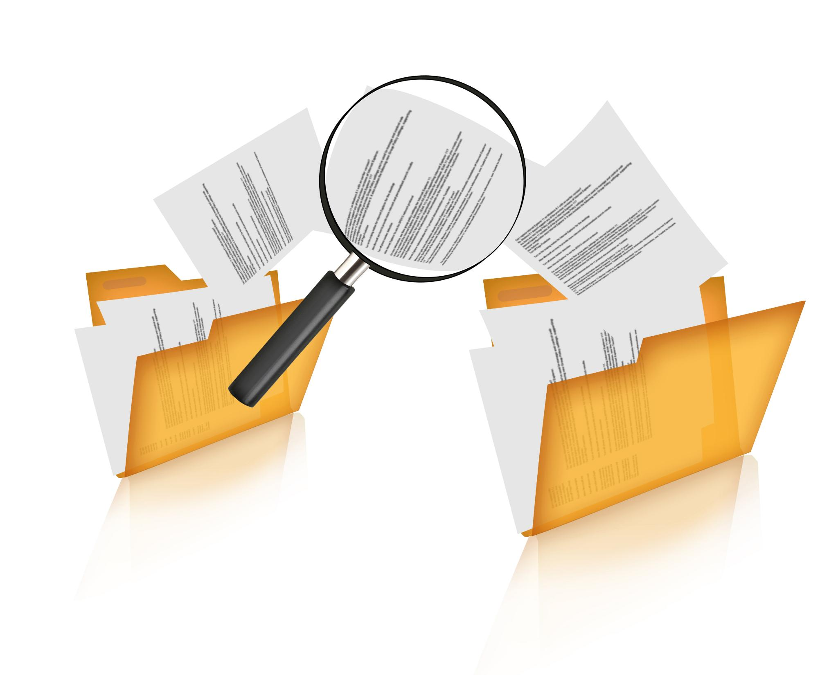
Automated Generation of Custom Documents
Dynamic Template Analysis
Utilizes an LLM to analyze the structure of any blank template, identifying sections and fields effectively.
Smart Content Mapping
Automatically fills templates with extracted resume data, ensuring accuracy guided by the analyzed structure.
Skill Matrix Logic
Incorporates logic for complex skill matrices, aligning resume qualifications with document requirements.
Efficiency Improvement
Streamlines document creation by automating processes, significantly reducing manual effort and enhancing consistency.
Notes:
--- This slide references information from the following file: https://watiusa-my.sharepoint.com/personal/rajesh_j_wati_com/_layouts/15/Doc.aspx?sourcedoc=%7B325946ED-BE65-4FCA-B439-612EC71673B7%7D&file=Skill%20Matrix%20Filler%20App_ppt_document%20(1).docx&action=default&mobileredirect=true Slide 6: Core Functionality 3: Dynamic Template Filling Title: Automated Generation of Custom Documents Bullet Points: Dynamic Template Structure Analysis: Uses an LLM to dynamically understand the layout, sections, and fields of any blank template. Smart Content Mapping: Precisely fills document templates with extracted resume data, guided by the inferred template structure. Specialized Skill Matrix Filling: Includes specific logic for handling complex skill/qualification matrix templates, dynamically matching resume experience to required qualifications. Significantly Reduces Manual Effort: Automates repetitive document creation, improving efficiency and consistency. Image Suggestion: An image showing a blank template on one side (perhaps with detected fields highlighted) and a filled-out document on the other, with an arrow indicating the intelligent filling process.

Slide 15
Key Technologies
Notes:
--- This slide references information from the following file: https://watiusa-my.sharepoint.com/personal/rajesh_j_wati_com/_layouts/15/Doc.aspx?sourcedoc=%7B325946ED-BE65-4FCA-B439-612EC71673B7%7D&file=Skill%20Matrix%20Filler%20App_ppt_document%20(1).docx&action=default&mobileredirect=true Under the Hood: Key Technologies

Slide 16

Under the Hood: Key Technologies
Flask Framework
Flask is a lightweight Python framework that simplifies building web applications through its easy-to-use structure.
Mistral Language Model
Mistral is a powerful local Large Language Model that excels in text understanding and generation tasks.
ChromaDB
ChromaDB is a vector database designed for efficient storage and retrieval of document embeddings, enhancing data access.
Document Handling Libraries
Libraries like python-docx, PyMuPDF, and mammoth provide robust functionalities for handling Word and PDF documents.
Notes:
--- This slide references information from the following file: https://watiusa-my.sharepoint.com/personal/rajesh_j_wati_com/_layouts/15/Doc.aspx?sourcedoc=%7B325946ED-BE65-4FCA-B439-612EC71673B7%7D&file=Skill%20Matrix%20Filler%20App_ppt_document%20(1).docx&action=default&mobileredirect=true Slide 7: Key Technologies - The Engine Room Title: Under the Hood: Key Technologies Bullet Points: Flask: Python framework for building the web application. Mistral (via Ollama): Powerful Large Language Model for text understanding and generation (running locally). ChromaDB: Vector database for efficient storage and retrieval of document embeddings. Sentence Transformers: For creating numerical representations (embeddings) of text. python-docx, PyMuPDF, mammoth: Libraries for robust handling of various Word and PDF document formats. Image Suggestion: Logos of the key technologies mentioned (Flask, Ollama, ChromaDB, Sentence Transformers, etc.) arranged neatly.

Slide 17
Ensuring Accuracy and Reliability
Notes:
--- This slide references information from the following file: https://watiusa-my.sharepoint.com/personal/rajesh_j_wati_com/_layouts/15/Doc.aspx?sourcedoc=%7B325946ED-BE65-4FCA-B439-612EC71673B7%7D&file=Skill%20Matrix%20Filler%20App_ppt_document%20(1).docx&action=default&mobileredirect=true Addressing Key Concerns

Slide 18

Addressing Key Concerns
Programmatic Name Accuracy
Dedicated pre-extraction ensures the candidate's name is always correct, eliminating AI hallucination for this critical field.
Context-Bound LLM Responses
LLM answers are strictly confined to information within the provided documents, preventing fabrication.
Structured Template Understanding
The app dynamically learns template layouts to ensure precise filling, even for complex forms.
Data Integrity
All extracted data is maintained in a structured JSON format, ensuring consistency and reliability.
Notes:
--- This slide references information from the following file: https://watiusa-my.sharepoint.com/personal/rajesh_j_wati_com/_layouts/15/Doc.aspx?sourcedoc=%7B325946ED-BE65-4FCA-B439-612EC71673B7%7D&file=Skill%20Matrix%20Filler%20App_ppt_document%20(1).docx&action=default&mobileredirect=true Slide 8: Robustness and Accuracy - Addressing Key Concerns Title: Ensuring Accuracy and Reliability Bullet Points: Programmatic Name Accuracy: Dedicated pre-extraction ensures the candidate's name is always correct, eliminating AI hallucination for this critical field. Context-Bound LLM Responses (RAG): LLM answers are strictly confined to information within the provided documents, preventing fabrication. Structured Template Understanding: The app dynamically learns template layouts to ensure precise filling, even for complex forms. Data Integrity: All extracted data is maintained in a structured JSON format, ensuring consistency and reliability. Image Suggestion: An image of a lock and key symbolizing security and accuracy, overlaid on a digital document.

Slide 19
Conclusion
Innovative Solution
The Skill Matrix Filler App represents a modern approach to managing resumes and skill data efficiently.
Streamlined Processes
The app streamlines recruitment processes, making it easier for HR teams to manage candidates' skill sets.
Enhanced Accuracy
By using advanced technologies, the app enhances the accuracy of skill data management and candidate evaluation.
Notes:
In conclusion, the Skill Matrix Filler App is an innovative solution that addresses the challenges of manual resume and skill data management. By leveraging advanced technologies, it streamlines processes, enhances accuracy, and improves the overall recruitment experience.

